Slide 1
Chapter 1
Units and Problem Solving

Slide 2
Homework for Chapter 1
Read Chapter 1
HW 1: pp. 26-31: 2,3,8,16,18,19, 28,29,38,39,52,54,56, 62, 68, 73, 74, 75.

Slide 3
Warmup
Perhaps the most recognizable equation in physics comes form Einstein’s theory of relativity: E = mc². It is the cornerstone of understanding nuclear energy reactions and has guided astrophysicists in their development of the Big Bang theory.
Einstein even liked to answer questions about life analytically. Once, when asked for advice about how to be successful, he replied “If A is success in life, then A = x + y + z. Work is x, y is play and z is
_ _ _ _ _ _ _ _ _ _ _ _ _ _ _ _ _ _ _ _ .”
(7 letters) (4 letters) (5 letters) (4 letters)
Solve the letter tile puzzle to find out what z is.
G Y U T H S H O U R K E E U T M O P I N
Phamous Phrases VIII (Physics Warmup #152)

Slide 4
Warmup: Solution
Einstein even liked to answer questions about life analytically. Once, when asked for advice about how to be successful, he replied “If A is success in life, then A = x + y + z. Work is x, y is play and z is
_ _ _ _ _ _ _ _ _ _ _ _ _ _ _ _ _ _ _ _ .”
(7 letters) (4 letters) (5 letters) (4 letters)
Solve the letter tile puzzle to find out what z is.
K E E P I N G Y O U R M O U T H S H U T
Phamous Phrases VIII (Physics Warmup #152)

Slide 5
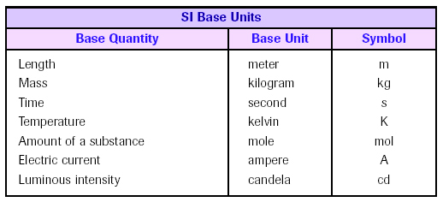
1.1 -1.3 International System of Units (SI)
Objects and phenomena are measured and described using standard units, a group of which makes up a system of units.
  - example: British System (feet, pounds)
  - SI is a modernized version of the metric system, base 10
SI has seven base or fundamental units.
A derived unit is a combination of the base units. ex: meters per second

Slide 6
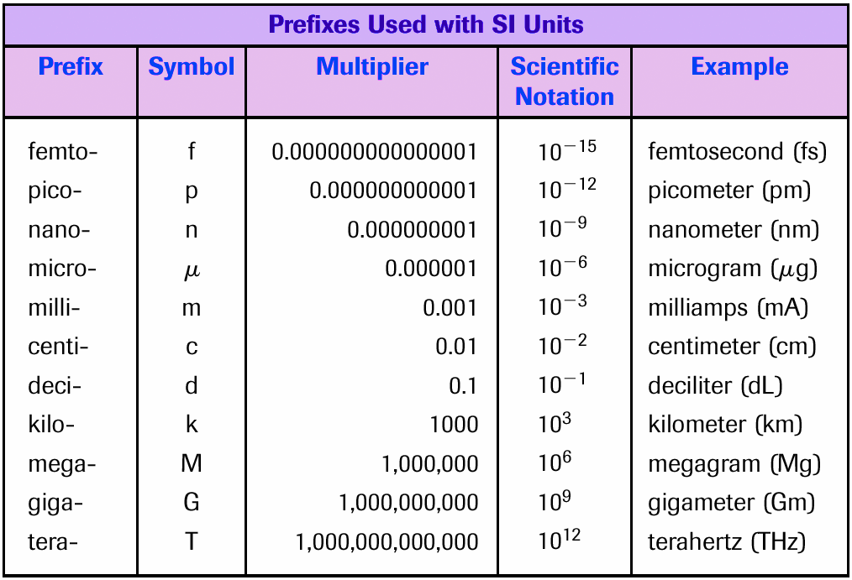
1.1 -1.3 International System of Units (SI)

Slide 7
1.4 Dimensional Analysis
The fundamental or base quantities, such as length [L] , mass [M] , and time [T] are called dimensions.
Dimensional Analysis is a procedure by which the dimensional correctness of an equation can be checked.
Both sides of an equation must not only be equal in numerical value, but also in dimension.
Dimensions can be treated like algebraic quantities.
Units, instead of dimensional symbols, may be used in unit analysis.

Slide 8
1.4 Dimensional Analysis
Dimensional or Unit Analysis can be used to
1) check whether an equation is dimensionally correct, i.e., if an equation has the same dimension or units on both sides.
2) find out the dimension or units of derived quantities.
Example 1.1:
Check whether the equation x = at² is dimensionally correct, where x is length, a is acceleration, and t is time interval.

Slide 9
1.4 Dimensional Analysis
Example 1.1: Check whether the equation x = at² is correct, where x is length, a is acceleration, and t is time interval.
Solution:
Dimensional analysis: left side of equation right side of equation
[L] = [L] x [T] ² = [L]
[T] ²
The dimension of the left side is equal to the right, so the equation is dimensionally correct.
Warning: dimensionally correct does not necessarily mean the equation is correct.
Unit analysis: Units of the left side are m
Units of the right side are (m/s²)(s²) = m Check √
variable | description | dimension | unit
x | length | [L] | m
a | acceleration | [L] / [T] ² | m/s²
t | time | [T] | s

Slide 10
1.5 Conversion of Units
A quantity may be expressed in other units through the use of conversion factors.
Any conversion factor is equal to 1, so multiplying or dividing by this factor does not alter the quantity.
Determine the correct conversion factor by dimensional (unit) analysis.
Example 1.3: A jogger walks 3200 meters every day. What is this distance in miles?
1 mile = 1609 meters, therefore, you may multiply by
( 1 mi ) or (1609 m)
(1609 m) (1mi)
but, which one to choose? Unit analysis to the rescue…
(3200 m ) x ( 1 mi ) = 1.99 mi ≈ 2.0 mi.
1 (1609 m)

Slide 11
1.5 Conversion of Units
Example 1.4: A car travels with a speed of 25 m/s. What is the speed in mi/h (miles per hour)?
Solution:
Here we need to convert meters to miles and second to hours. We can use the conversion factor (1 mi / 1609 m), to convert meters to miles and (3600 s / 1 h) to convert seconds to hours.
(25 m ) x ( 1 mi ) x (3600 s) = 56 mi
( 1 s ) (1609 m) ( 1 h ) h
We can also use the direct conversion (1 mi/h = 0.447 m/s).
(25 m ) x ( 1 mi /h ) = 56 mi
( 1 s ) (0.447 m/s) h

Slide 12
Check for Understanding
a. What is the difference between standard units and a system of units?
Standard units are things like meters, seconds, newtons. A group of standard units make a system of units, such as metric, English, or SI.
b. What is SI and what are the 3 main base units?
SI is a newer version of the metric system, which is base-10. The three main units are m, kg, s.
c. What does the prefix kilo- mean?
d. What does the prefix centi- mean?
e. What does the prefix mega- mean?
f. What does the prefix micro- mean? What Greek letter is used?
g. What does the prefix milli- mean?
h. Why would I use dimensional or unit analysis?
1000
10⁻²
million or 10⁶
10⁻⁶
μ
10⁻³
to make sure my formula is correct or to find the units of my answer

Slide 13
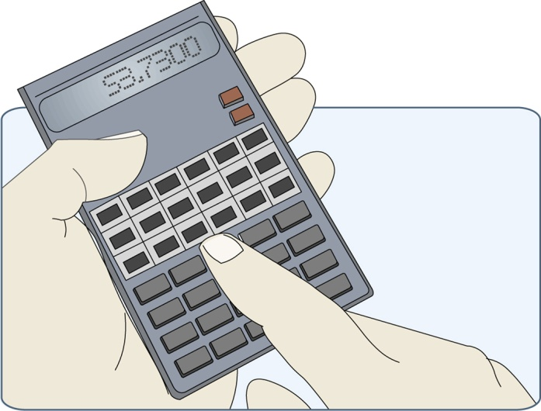
1.6 Significant Figures
• Exact numbers have no uncertainty or error
ex: the 100 used to calculate percentage
ex: the 2 in the equation c = 2π r
• Measured numbers have some degree of uncertainty or error.
• When calculations are done with measured numbers, the error of measurement is propagated, or carried along.
• The number of significant figures (or digits) in a quantity is the number of reliably known digits it contains.
• There are some basic rules that can be used to determine the number of significant digits in a measurement.

Slide 14

1.6 Significant Figures
Definition: All the valid digits in a measurement, the number of which indicates the measurement’s precision (degree of exactness).
also called significant figures, or sig figs
Use the Atlantic & Pacific Rule to determine the sig figs.
PACIFIC
OCEAN
ATLANTIC
OCEAN

Slide 15
1.6 Significant Figures
If the…
Decimal is Absent
  Count from the Atlantic side from the first non-zero digit.
Decimal is Present
  Count all digits from the Pacific side from the first non-zero digit.

Slide 16
1.6 Significant Figures
Examples:
421
Decimal is absent -> Atlantic; three significant figures
421 000
Decimal is absent -> Atlantic; three significant figures
42.100
Decimal is present -> Pacific; five sig figs
4.201
four sig figs
0.421
three sig figs
0.000421
three sig figs

Slide 17
1.6 Significant Figures
To eliminate doubt, write the number in scientific notation.
4.2100 x 10⁵ – five sig figs
4.21 x 10⁵ – three sig figs
A bar placed above a zero is also acceptable.
4, 210, 000 – five sig figs
4, 210, 000 – seven sig figs
To avoid confusion, for the purpose of this course we will consider numbers with trailing zeros to be significant.
ex: 20 s has two sig figs, even if it is not written as 2.0 x 10¹ s

Slide 18
1.6 Significant Figures
• When you perform any arithmetic operation, it is important to remember that the result never can be more precise than the least-precise measurement.
• The final result of an addition or subtraction should have the same number of decimal places as the quantity with the least number of decimal places used in the calculation.
Example: 23.1
4.77
125.39
+ 3.581
156.841 Round to 156.8 (one decimal place)

Slide 19
1.6 Significant Figures
• To multiply or divide measurements, perform the calculation and then round to the same number of significant digits as the least-precise measurement.
(3.64928 x 10⁵) (7.65314 x 10⁷)
(5.2 x 10⁻³) (5.7254 x 10⁵) least precise measurement
= (3.64928 x 10⁵) x (7.65314 x 10⁷) ÷ (5.2 x 10⁻³) ÷ (5.7254 x 10⁵)
= 9.3808 x 10⁹
= 9.4 x 10⁹ because the least precise measurement has 2 sig figs.

Slide 20
1.6 Significant Figures
Rules for Rounding Off
• In a series of calculations, carry the extra digits through to the final
answer, then round off. ROUND ONLY ONCE AT THE END OF YOUR CALCULATION!
• If the digit to be removed is:
• <5, the preceding stays the same.
example: 1.33 rounds to 1.3
• 5 or greater, the preceding digit increases by 1.
example: 1.36 rounds to 1.4.
Example: Round 24.8514 to three figures.
Look at the fourth figure. It is a 5, so the preceding digit increases by 1. The original number becomes
24.9

Slide 21
1.6 Significant Figures
Percent error is used to determine accuracy, or the variation of a measurement compared to the accepted or theoretical value.
Percent error = measured value – accepted value × 100%
accepted value
Example: The accepted value for the acceleration due to gravity is 9.80 m/s². The experimental results on the first trial was 8.50 m/s². What was the percent error?
8.50 m/s² – 9.80 m/s² x 100% = 13.3%
9.80 m/s²
Percent deviation is used to determine precision, or the closeness of measurements to each other.
Percent deviation = measured value – average value × 100%
average value

Slide 22
1.7 Problem Solving
• Problem solving is a skill learned by practice, practice, practice.
• The procedure you use will be unique; develop what works for you.
HOWEVER, This is a procedure you can follow and build on.
Say it in words (talk it out).
Read the problem carefully and analyze it.
Write down the given data (knowns) and what you are to find (unknowns).
2. Say it in pictures
Draw a diagram, if appropriate.
3. Say it in equations.
Select your equations.
4. Simplify the equations.
Isolate the unknown variable before plugging in numbers.

Slide 23
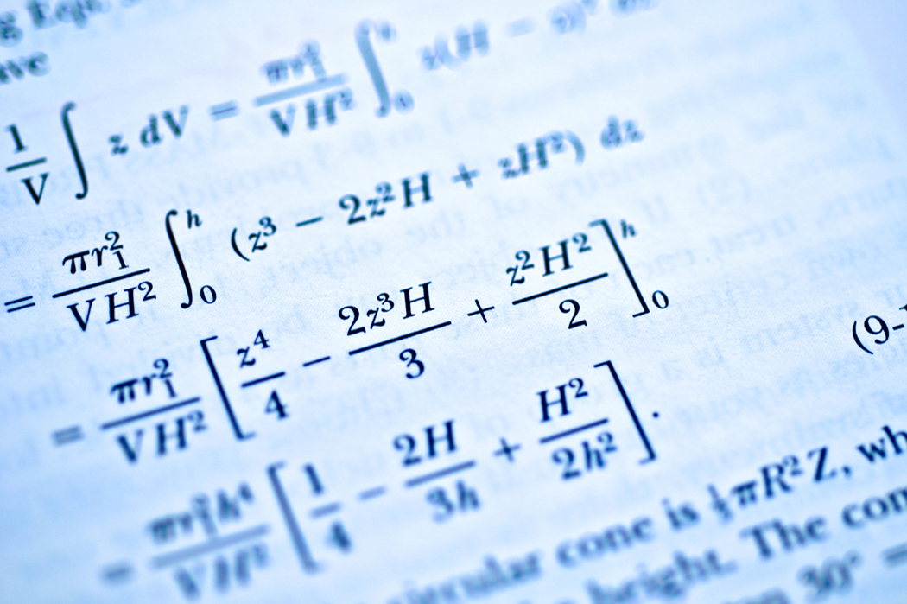
1.7 Problem Solving
5. Check the units.
Do this before calculating.
6. Plug in numbers and calculate; check significant figures.
Box your answer with units.
7. Check the answer. Is it reasonable?
Mrs. P’s Tip:
Always show your work; partial credit is a beautiful thing.

Slide 24
Check for Understanding
a. What is the difference between an exact number and a measured number?
b. What is the Atlantic / Pacific Rule?
c. What is the rule for addition and subtraction?
d. What is the rule for multiplication and division?
An exact number has no uncertainty or error, and a measured number does.
If the decimal is absent, count from the Atlantic side from the 1st non-zero digit. If the decimal is present, count from the Pacific side from the 1st non-zero digit.
The result of your calculation can never be more precise than the least precise measurement, meaning places after the decimal point.
The product or quotient has the same number of sig figs as the least precise number.

Slide 25
Check for Understanding
e. What are the rules for rounding?
f. Describe a good problem solving strategy.
Look at the figure to the right of the figure that is to be last.
If it is less than 5, drop it and all the figures to the right of it.
If it is greater than or equal to 5, increase by 1 the number to be rounded.
Talk it out
Draw a picture
Write your equations
Isolate the unknown variable before plugging in numbers
Check the units
Calculate and solve
Does the answer make sense?
HW 1: pp. 26-31: 2,3,8,16,18,19, 28,29,38,39,52,54,56, 62, 68, 73, 74, 75.

Slide 26
1.6 Significant Figures
Percent error is used to determine accuracy, or the variation of a measurement compared to the accepted or theoretical value.
Percent error = measured value – accepted value × 100%
accepted value
Example: The accepted value for the acceleration due to gravity is 9.80 m/s². The experimental results on the first trial was 8.50 m/s². What was the percent error?
8.50 m/s² – 9.80 m/s² x 100% = 13.3%
9.80 m/s²

